Slide 1



Welcome to the
TC-10 / TC-11 Joint Meeting
November 14, 2012
Tsukuba, Japan

Slide 2
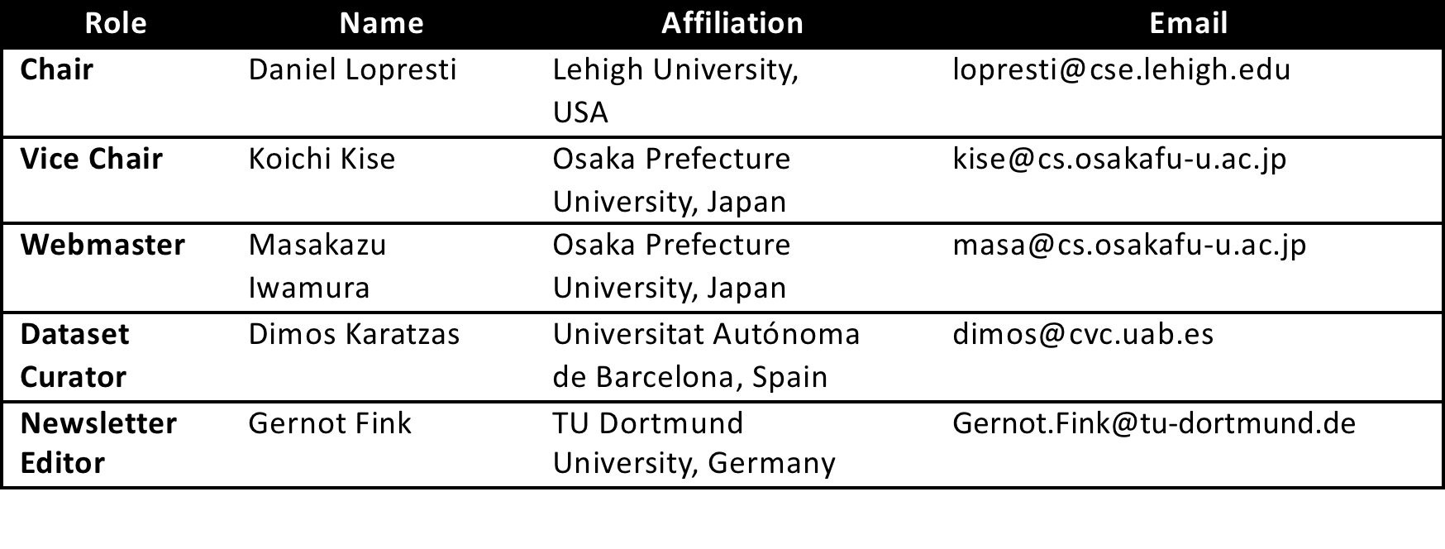
TC-11 Leadership Team for 2008-12
It has been our great pleasure to serve the community.
Look for a new leadership team to be announced soon.
New volunteers are always encouraged to get involved!

Slide 3
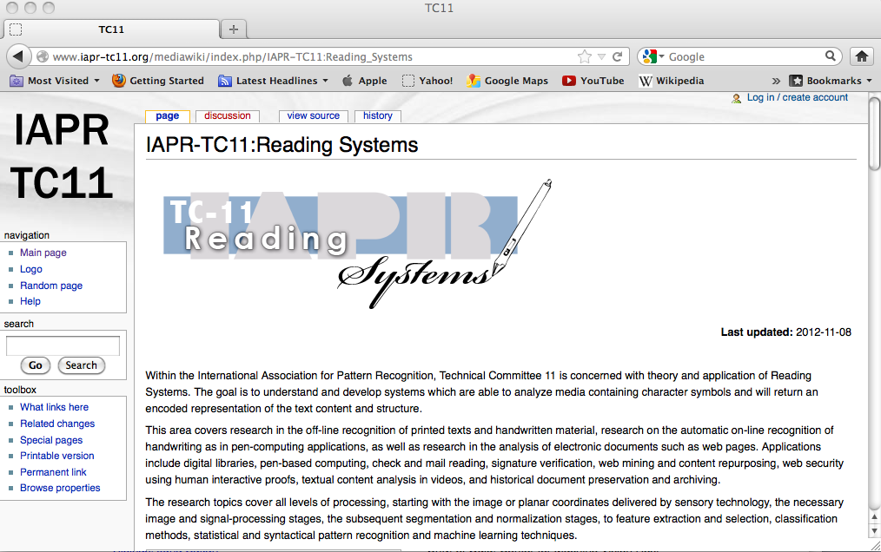
TC-11 Website
http://www.iapr-tc11.org/

Slide 4
TC-11 Website Contents
1 What's New?
2 TC11 Officers
3 Research Areas
4 Activities
4.1 Journals
4.2 Conferences
4.3 Datasets
4.4 Softwares
4.5 Projects
4.6 Forum
5 Newsletters
5.1 Newsletter Archive
5.2 How to receive the IAPR
TC-11 newletters?
6 Reports
7 DAS Discussion Groups
8 Logo
http://www.iapr-tc11.org/

Slide 5
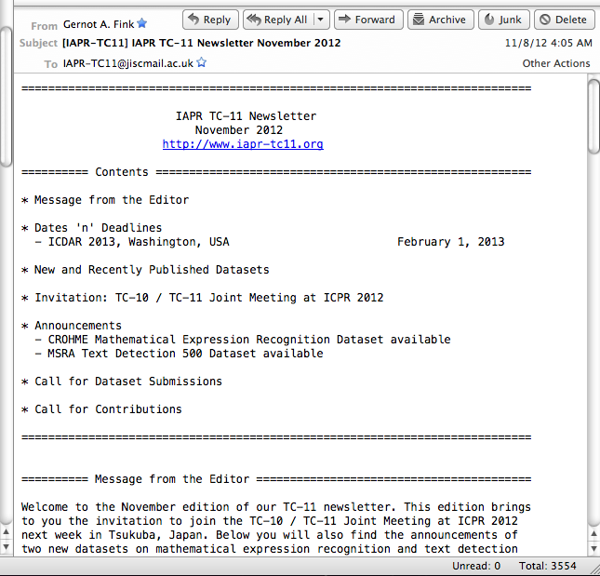
TC-11 Monthly Newsletter
A range of news items and announcements of interest to the TC-11 community.
1,544 subscribers as of November 10th.
JISCMail server.
To subscribe, visit TC-11 website.
Community contributions encouraged!

Slide 6
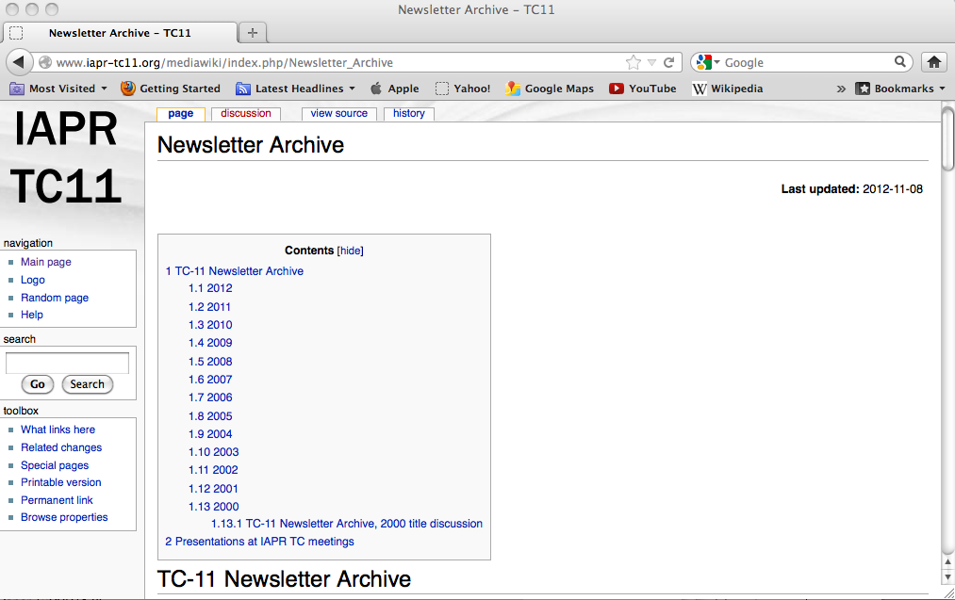
TC-11 Newsletter Archive
Past newsletters available via JISCMail server or TC-11 website.

Slide 7
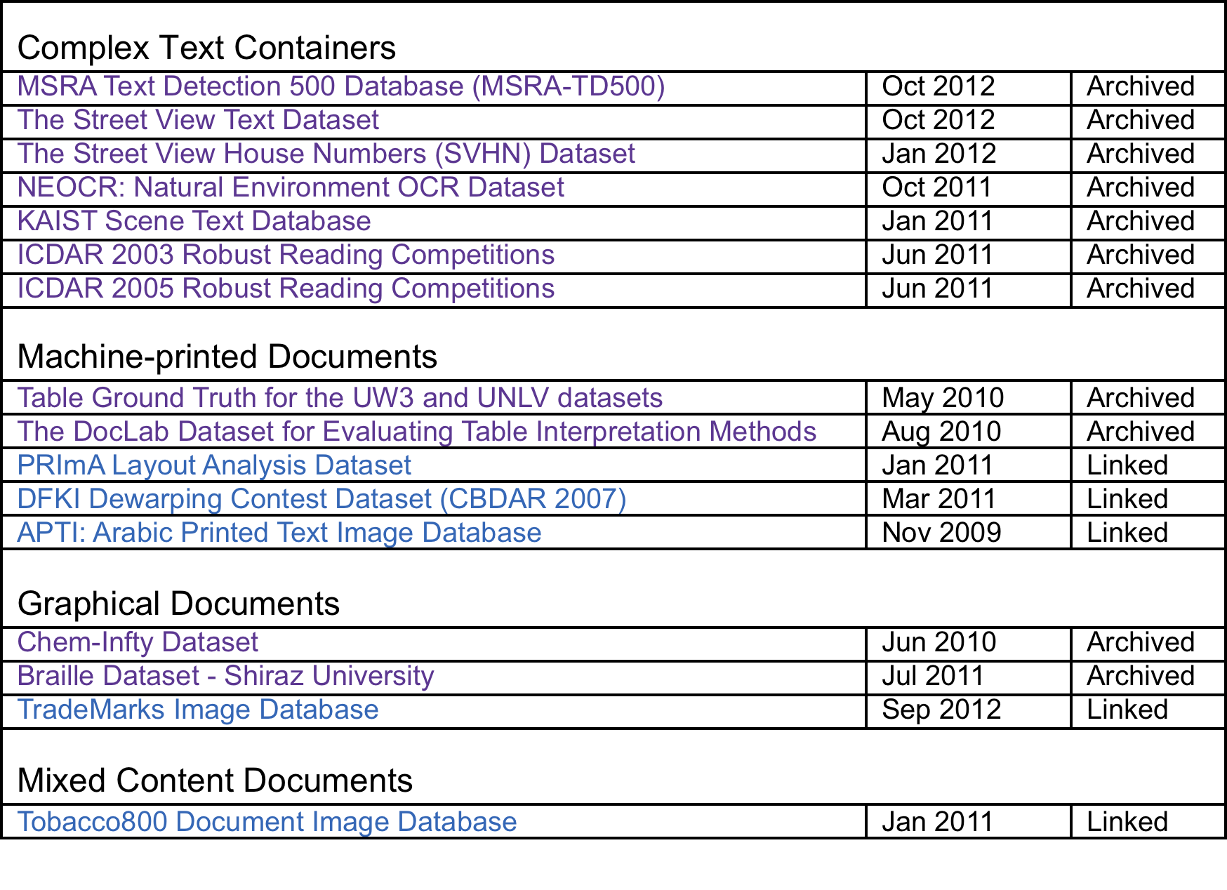
TC-11 Dataset Archive
http://www.iapr-tc11.org/mediawiki/index.php/Datasets

Slide 8
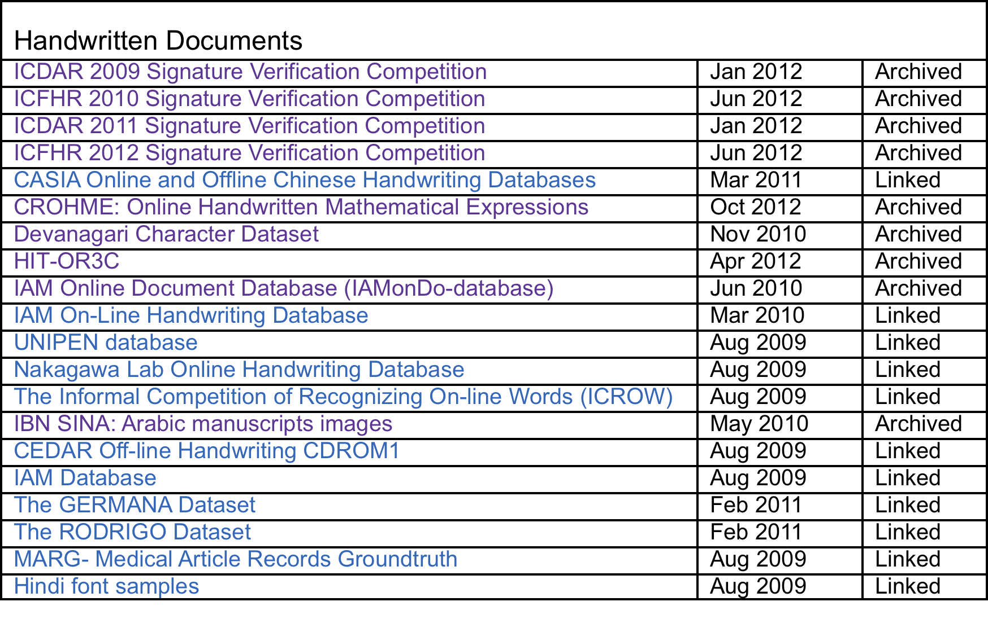
TC-11 Dataset Archive

Slide 9
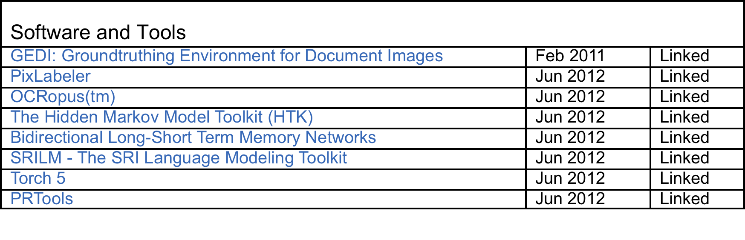
TC-11 Dataset Archive
Use the TC-11 Dataset Archive as a resource!
If you have data to contribute, let us know!!

Slide 10
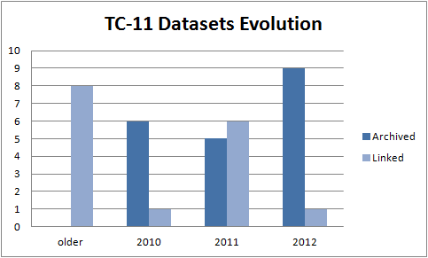
TC-11 Dataset Archive
TC-11 archiving datasets ensures better long-term stability.

Slide 11
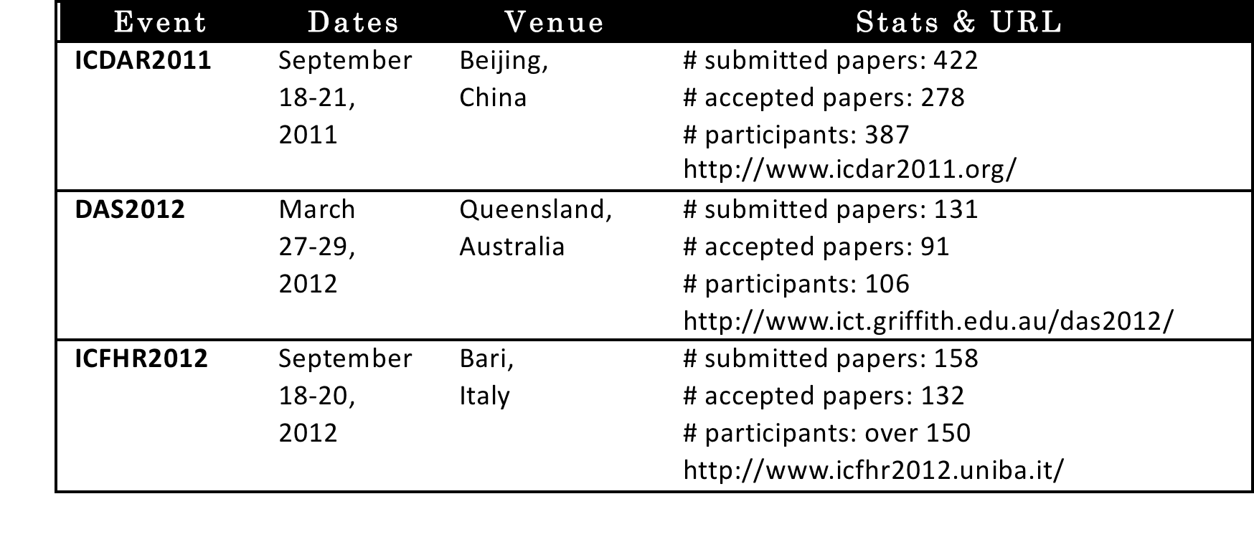
TC-11 Conferences
Also associated workshops: CBDAR, MOCR, AND, HIP
(please excuse any omissions).

Slide 12
TC-10/TC-11 Doctoral Consortium
Our first-ever Doctoral Consortium was held in conjunction with ICDAR 2011 in Beijing.
Goal: to create an opportunity for Ph.D. students to test their research ideas, present their current progress and future plans, and receive constructive criticism and insights related to their future work and career perspectives.
Half-day program with introductory remarks to explain to students the roles of TC-10 and TC-11.
“Pep talk” on Advice for a Successful Ph.D. Experience.
Student poster session and best poster awards.
21 Ph.D. students and 19 mentors participated (no charge).

Slide 13
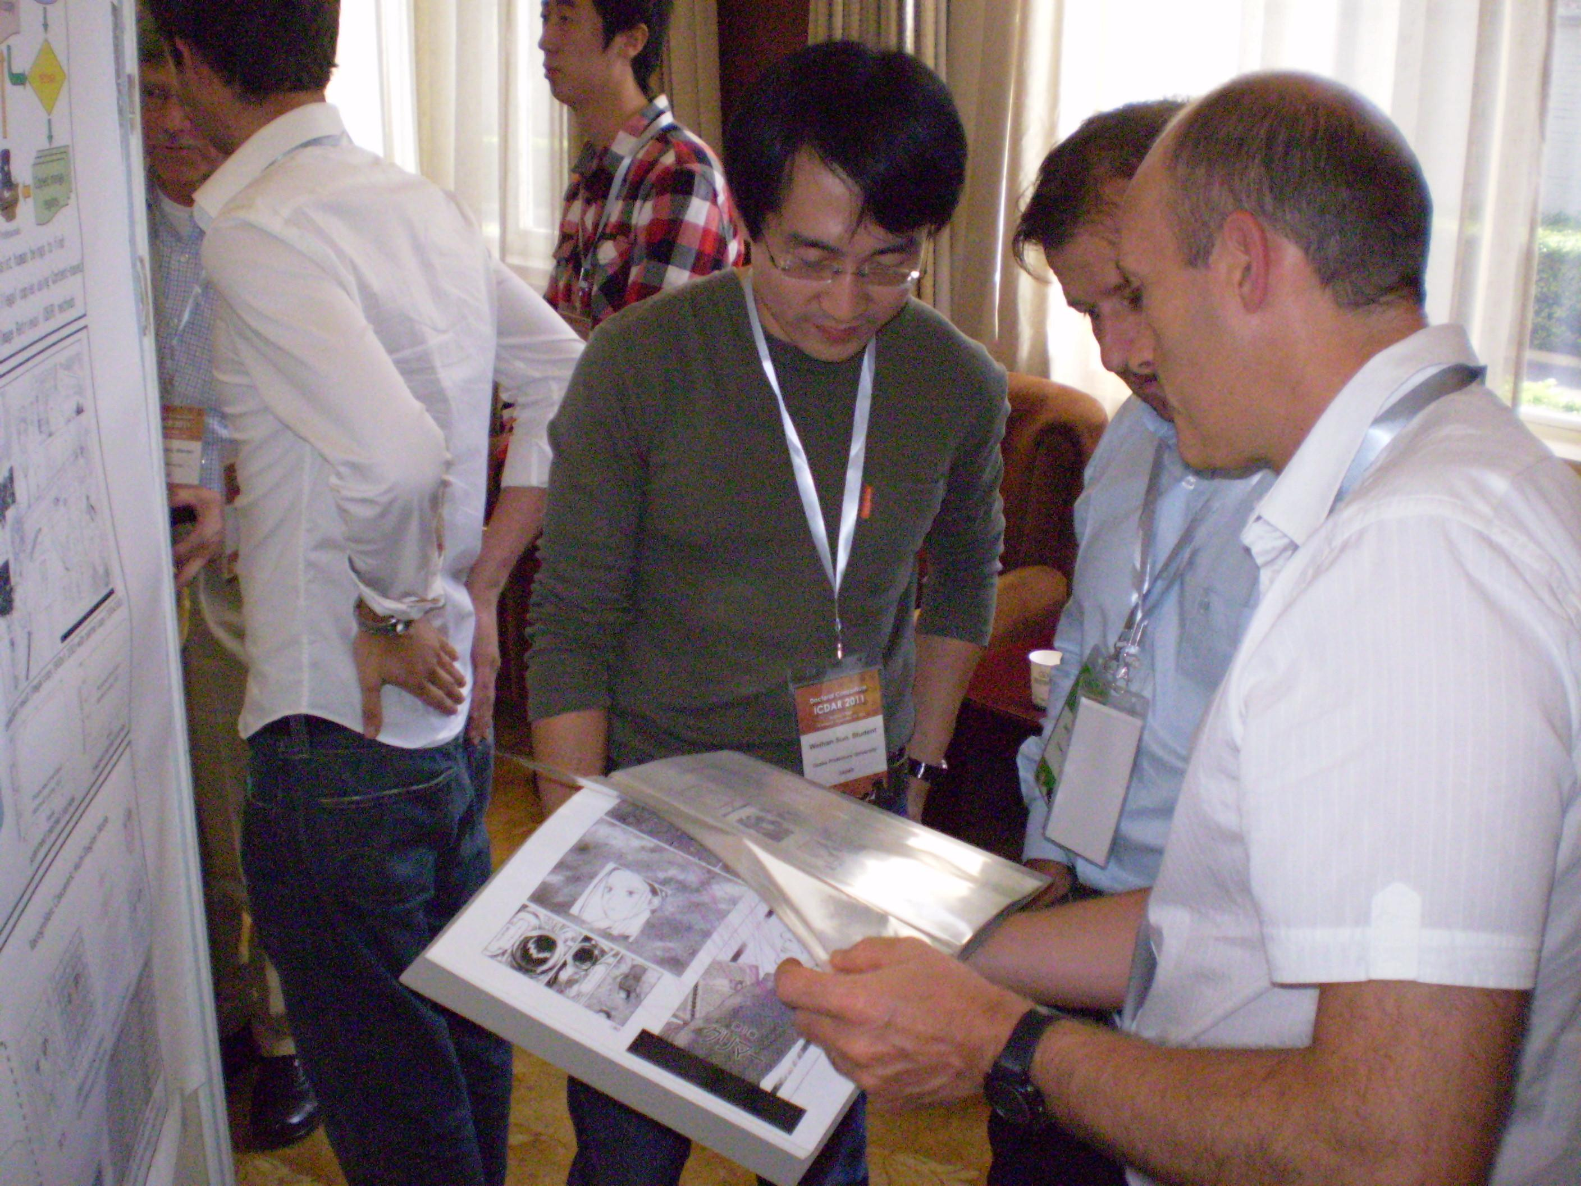
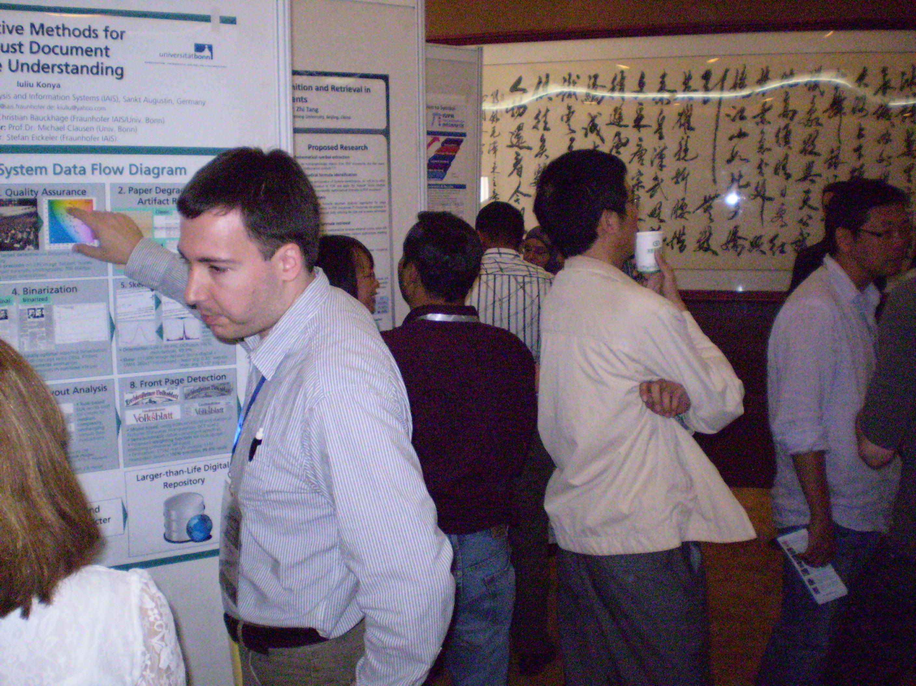
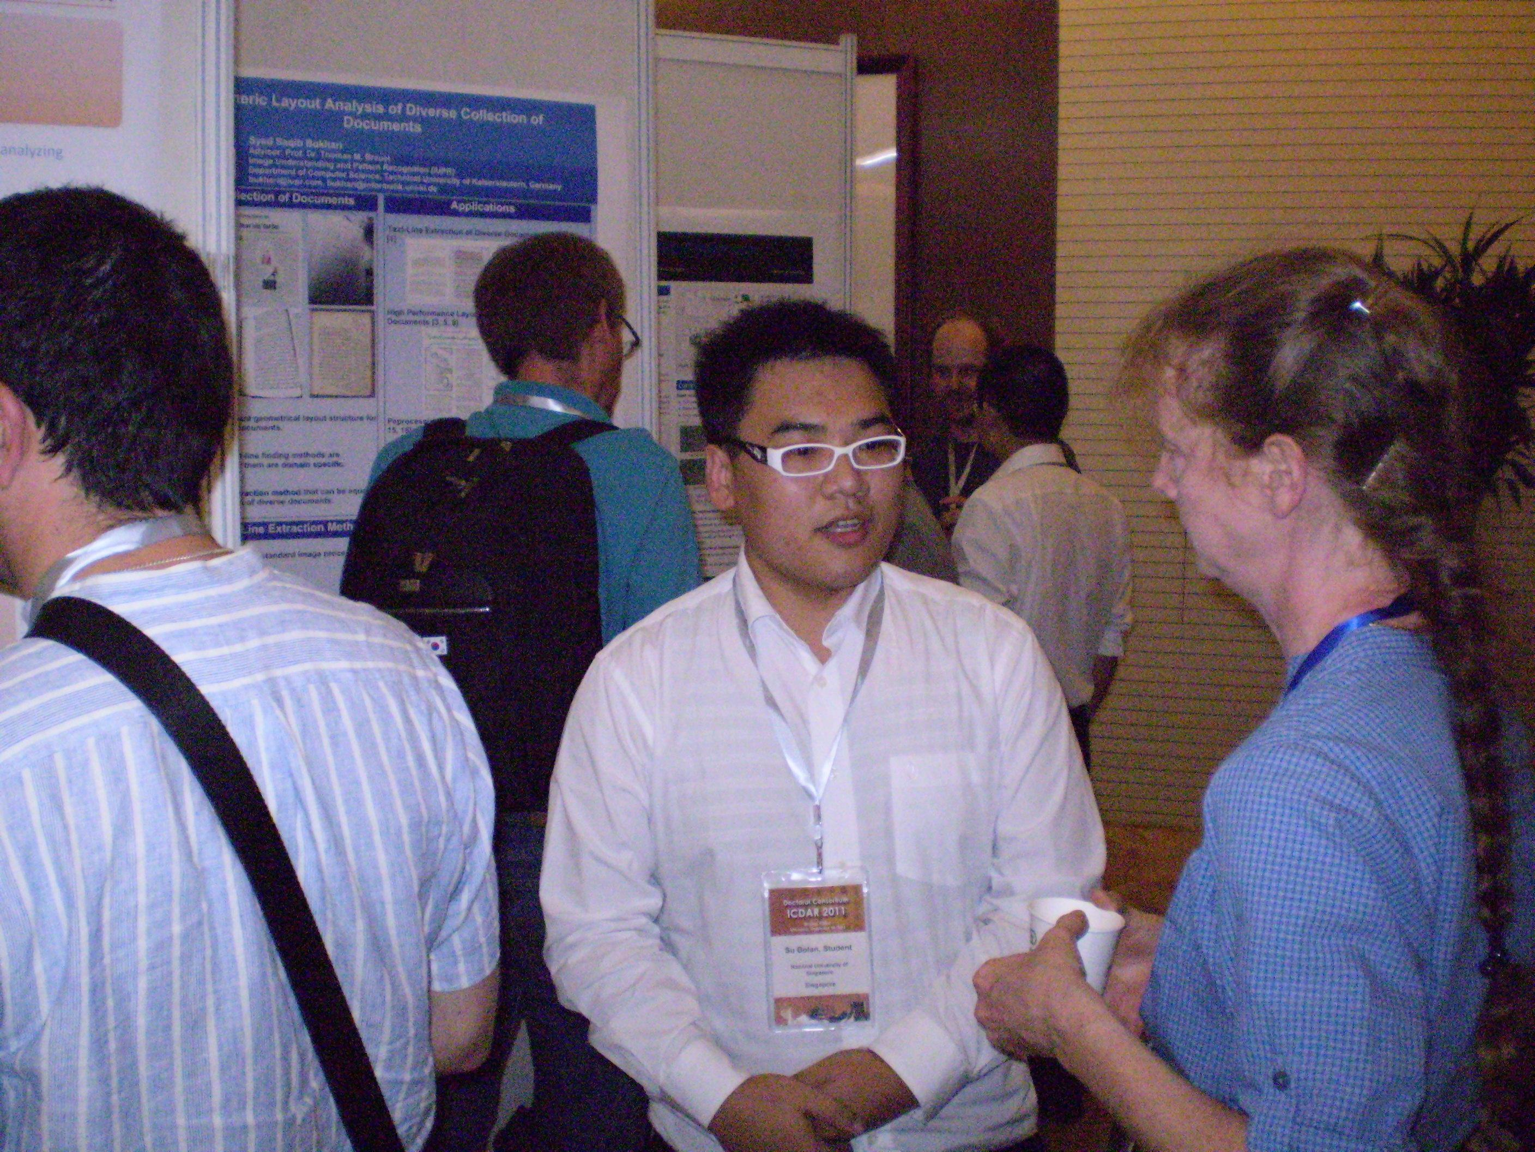
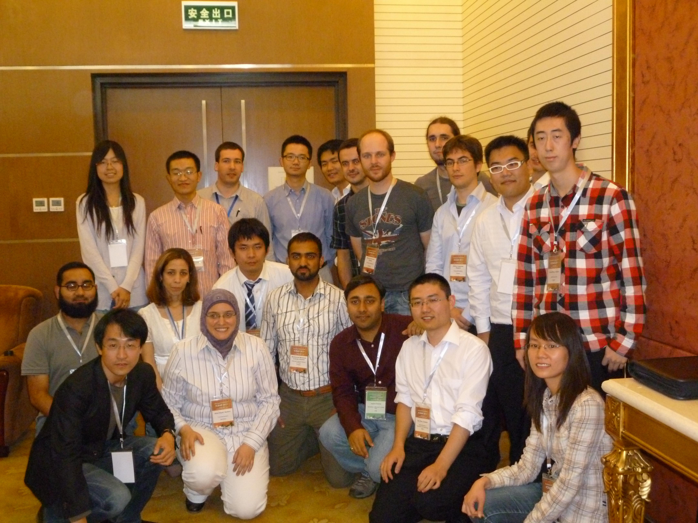
TC-10/TC-11 Doctoral Consortium

Slide 14
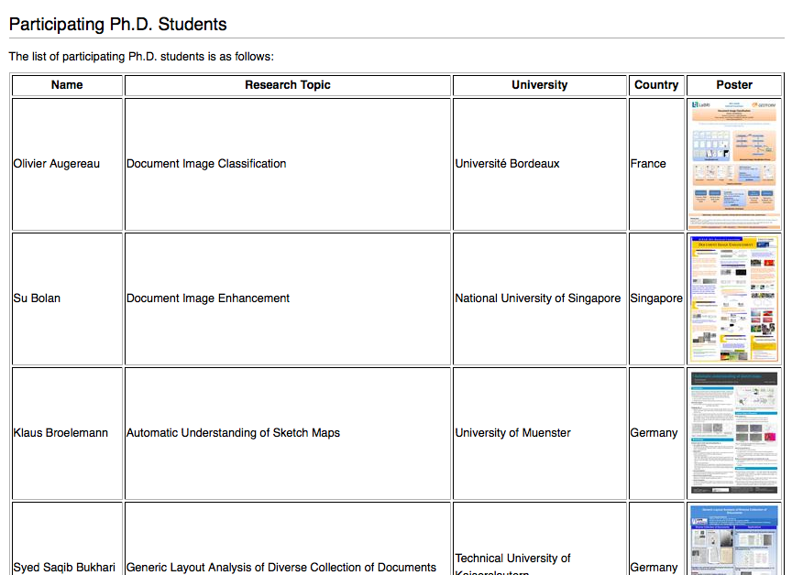
Doctoral Consortium on TC-11 Website
Student posters, as well as program, proceedings, photos, etc.

Slide 15
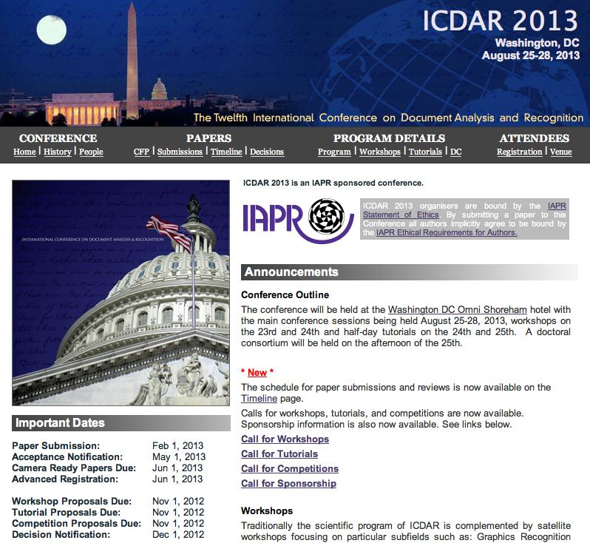
Upcoming Events
ICDAR 2013 in Washington, DC on Aug. 23-28; includes workshops, tutorials, doctoral consortium.
ICFHR 2014 in Crete, Greece.
DAS 2014 TBD.
ICDAR 2015 in Tunis, Tunisia.
ICFHR 2016 in Shenzhen, China.

